Slide 2
Presentation Outline
Abstract
Introduction
Background, Problem Statement, Objectives, Justification
Recap
- Literature review.
- Proposed Methodology.
Designs
- Discharge flow control
- Discharge collection
Expected outcomes
Time plan and Budget.
Way Forward
Notes:
10/13/2020
2

Slide 3
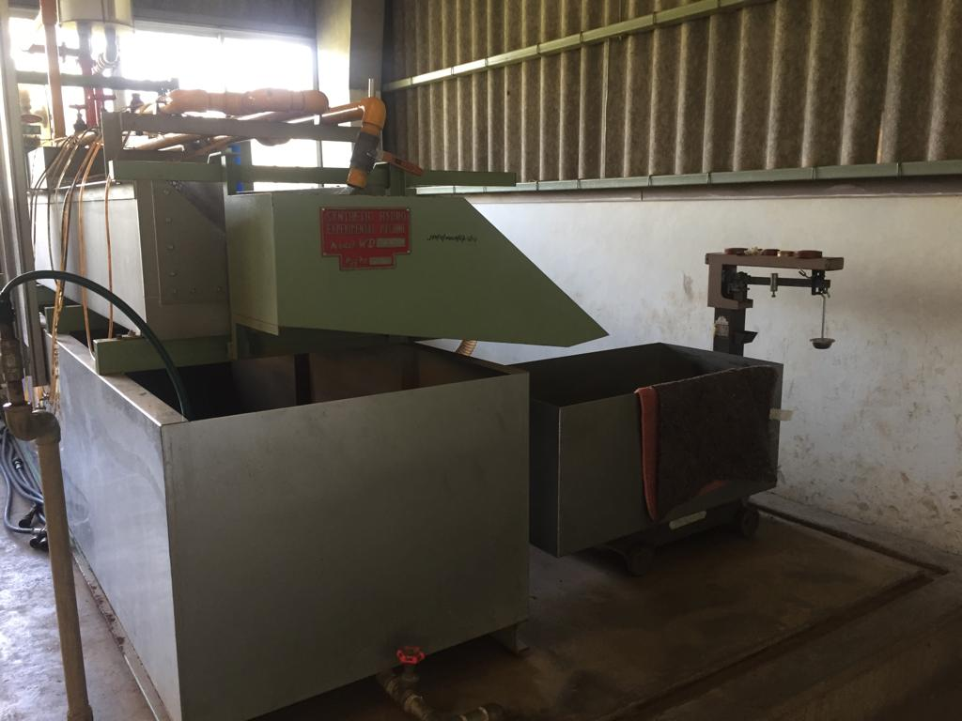
Synthetic Hydro-Experimental Machine

Slide 4
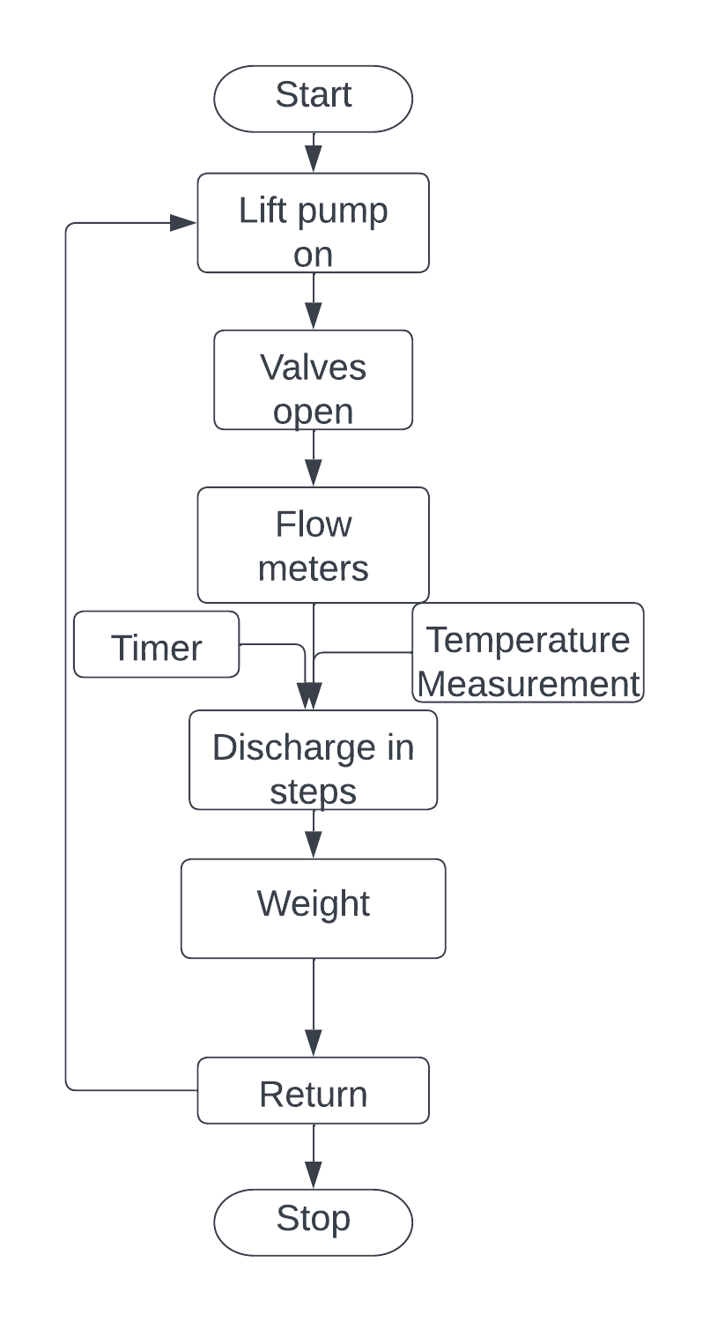
Introduction: Background
Fluid flow measurement
Quantifying a property of an uninterrupted flow.
Flow meters
Turbine flow meter, rotameter, venturi, and orifice.
Bernoulli’s Theorem.
Synthetic Hydro-Experimental Machine
Consists of venturi, and orifice
Establishing a relationship between discharge, differential pressure, and the coefficient of discharge.
Experiment procedure
Notes:
Fluid flow property measured and related to the flow. (relating pressure to the flow)
Each flow meter alter a physical property and the measures the change.
Bernoulli’s theorem – an increase in the velocity of a fluid occurs simultanously with a decrease in static pressure.
Procedure

Slide 5
Introduction: Problem Statement
Fluid flow experiments required one to synchronize discharge collection with time and temperature measurement.
Current state of the Synthetic Hydro-Experimental Machine.
Determination of steps based on human intuition
Discharge collection synchronization by a minimum of two operators
Incremental weight measurement.
Results in Cd outside the tolerable range.
Automated Synthetic Hydro-Experimental Machine
Precise discharge flow control.
Automated discharge collection.
Automate discharge weight and temperature measurement.

Slide 6
Introduction: Objectives
Main Objective
To automate the discharge collection process of the Synthetic Hydro-Experimental Machine.
Specific Objectives
To design an automated discharge flow control unit that can precisely discharge in steps.
To design and fabricate a discharge collection unit with automated weight, time and temperature measurements.
To design a user interface and the control algorithm.

Slide 7
Recap
Methodology
Discharge flow control : Choices: Servo, and Stepper motors
Main considerations: Torque requirements and step size
Discharge collection : Choices: Electromagnetics, Piezoelectric, Motor, Tank shape
Main considerations: Response time, Consistency
Interface and Control : Choices: LCD with keypad, knobs, and touch, STM32, ESP, Pi
Main considerations: Ergonomics, Processing capacity, power requirements.
Literature
Existing Technologies
- Computational fluid dynamics
- Analytical predictions
Related Works
- Electromagnetic Actuation – Automated Water Sampler
- Pneumatic Control
– Pneumatic Dispenser
Gaps
- Credibility of the experiment.
- Resources
- Error margins

Slide 8
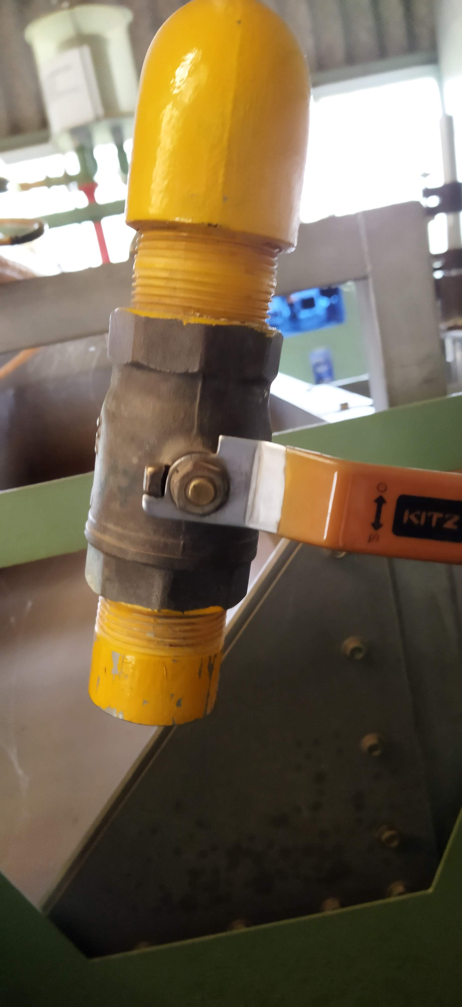
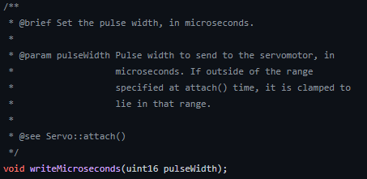
Design: Discharge flow control
Requirements: - Utilizing the existing ball valve
- Step sizes
- Torque requirement
Considerations
Stepper Motors
Micro-step driver.
Typically 1.8⁰ and sometimes 0.9⁰
Low-speed application < 1500rpm
Servo Motors
Optional driver
High-speed application > 1500rpm
Smaller angles, typically 1⁰
Choice
Servo Motors
Justification
Smaller angles less than 1⁰
can be achieved by writing smaller pulse widths.
Smaller step angles = more steps

Slide 9
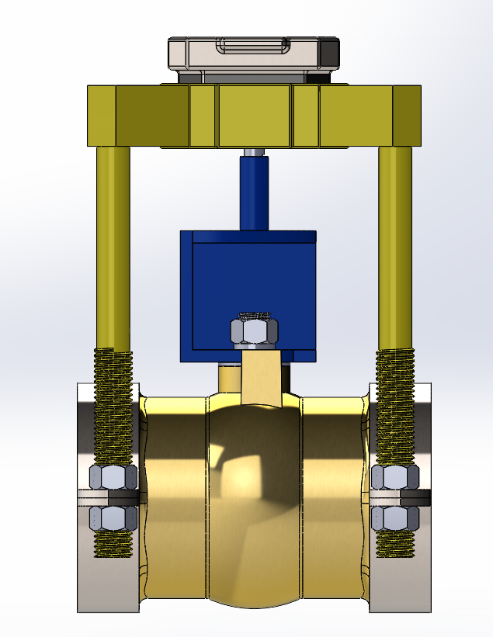
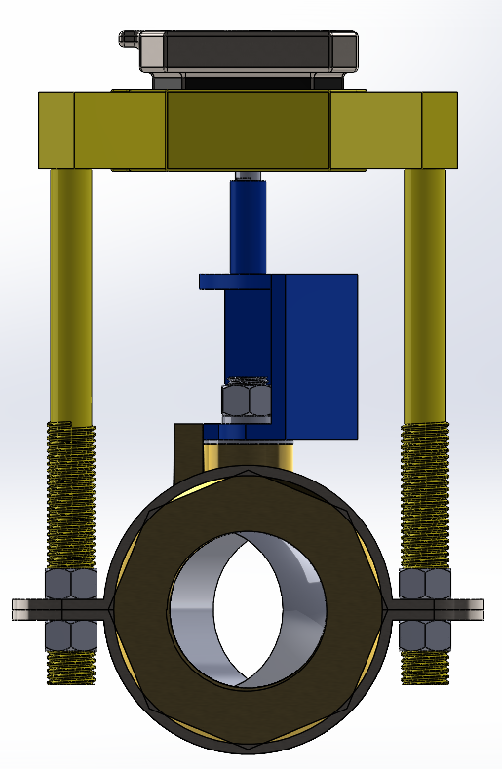
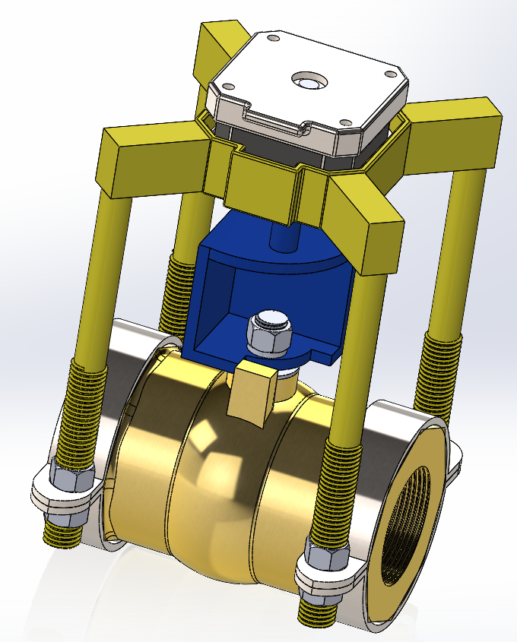
Design: Discharge flow control
Servo Motor
Interface
Pipe clamps

Slide 10
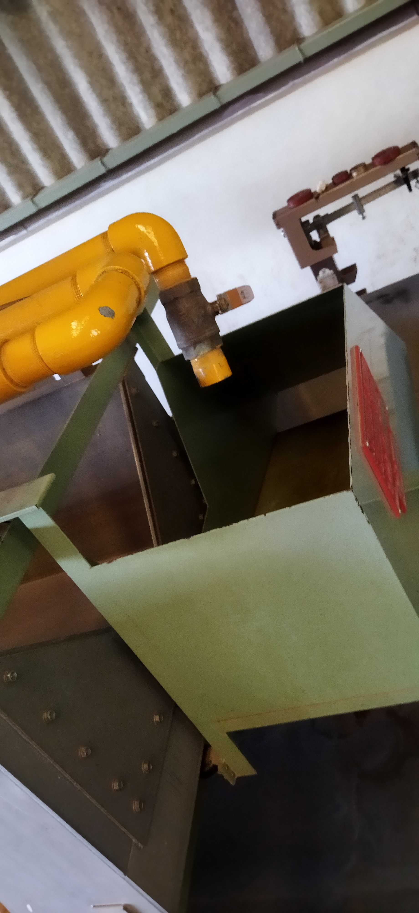
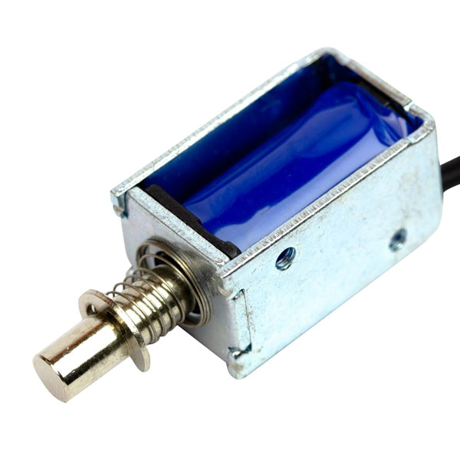
Design: Discharge collection unit
Flow Diversion
Requirements: - Response time.
- Force requirements.
Considerations
Electromagnetic Actuator
Linear push and pull.
Strength in a stroke = 5N/10mm
Servo motor
Bidirectional rotary motion.
Variable torque
Choice
Electromagnetic Actuator
Justification
Direct linear push and pull motion
Simple kinematic mechanism to amplify the displacement.

Slide 11
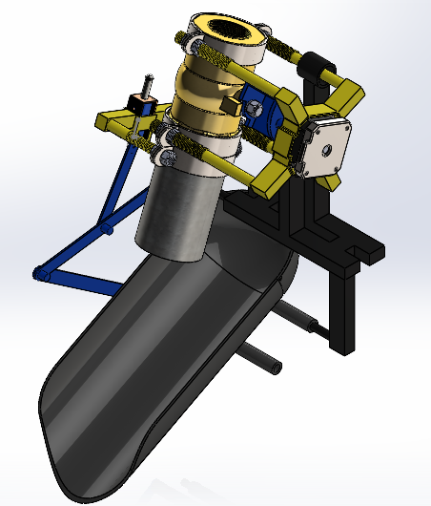
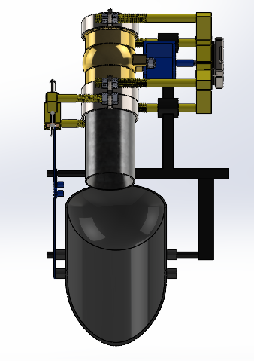
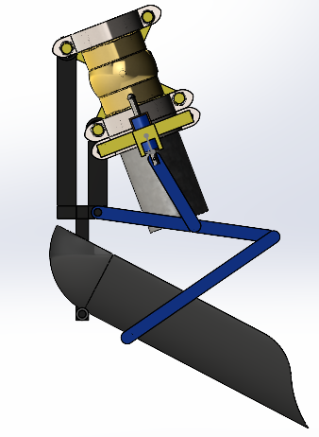
Design: Discharge Collection Unit

Slide 12
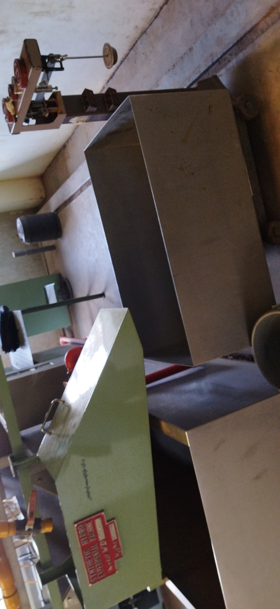


Design: Discharge collection unit
Discharge collection tank.
Requirements: - Motivated discharge
- Capacity of not less than 20 Liters.
Considerations
Choice
Horizontal Cylindrical tank.
Justification
Motivated discharge
Easier to fabricate

Slide 13
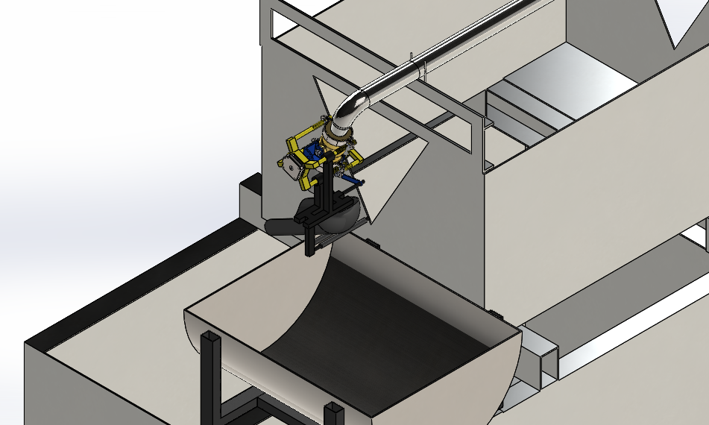
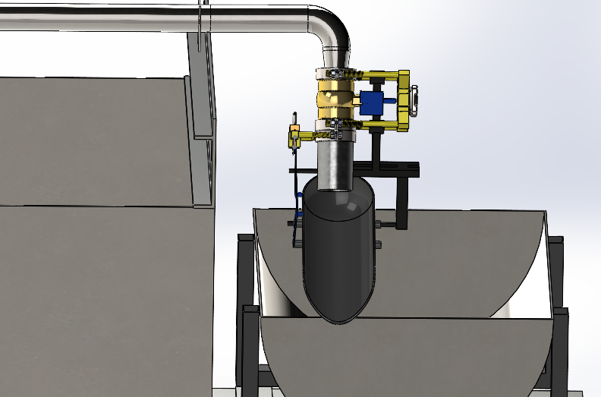
Design: Discharge collection unit

Slide 14
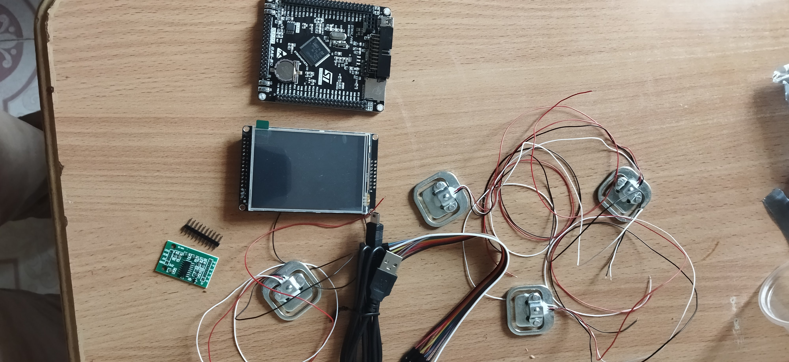
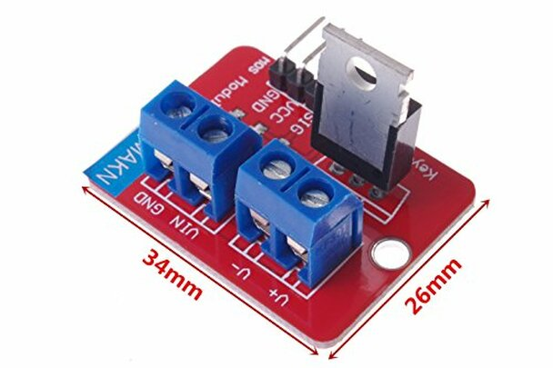
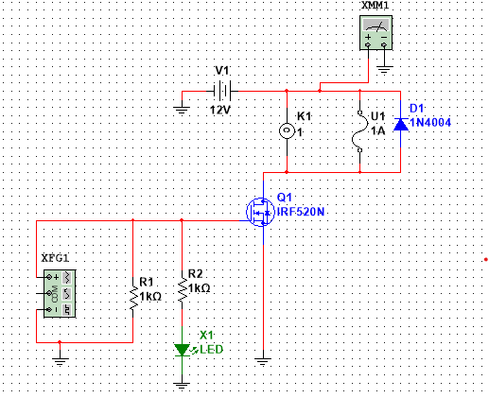
Design: Electrical and electronics
Electromagnetic Actuator
IRF520 MOSFET Driver module
STM32F407VET6
Other components
LCD touch 320x240 (ILI9341)
Load cells (50kg)

Slide 15
Expected Outcomes
Discharge flow control
- Can turn the ball valve in precise steps.
- Accuracy of the steps is to the nearest whole number.
Discharge collection unit
- Synchronized discharge collection with temperature and weight measurements.
Flow diversion unit
- Accurate collection of the stream within the time interval.
Discharge collection tank.
- Correctly shaped for accurate weight measurement.
- Utilize gravity to eliminate the need for an extra pump.
Control and display
- Ergonomic Display
- Capable board

Slide 16
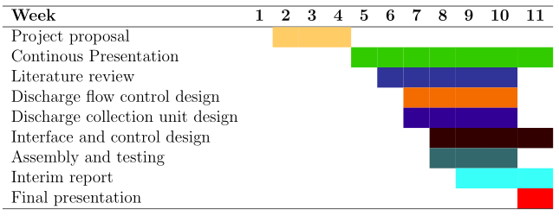
Time plan

Slide 17
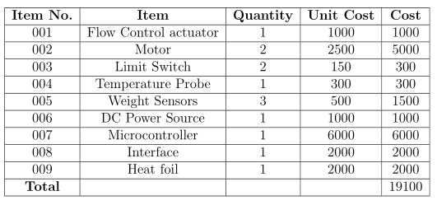
Budget

Slide 18
Way forward
Refine the designs.
Fabrication logistics.
Procurement of electrical and electronic components.

Slide 19


